Slide 1


SOFTWARE ENGINEERING (Week-1)
Usama Musharaf
MS-CS (Software Engineering)
Lecturer (Department of Computer Science)
FAST-NUCES Peshawar

Slide 2
Course Content
Introduction to Computer‑based System Engineering;
Project Management; Software Specification; Requirements Engineering, System Modeling; Requirements Specifications; Software Prototyping;
Software Design: Architectural Design, Object‑Oriented Design, Function‑Oriented Design, User Interface Design;
Quality Assurance; Processes & Configuration Management;
Introduction to advanced issues:
Reusability, Patterns;
Assignments and projects on various stages and deliverables of SDLC.

Slide 3
Recommended Books
Text Books
Software Engineering, Sommerville I., 10th Edition, Pearson Inc., 2014
Software Engineering, A Practitioner’s Approach, Pressman R. S.& Maxim B. R., 8th Edition, McGraw-Hill, 2015.

Slide 4
Objective of this Course
To familiarize students to the fundamental concepts, techniques, processes, methods and tools of Software Engineering,
To help students to develop basic skills that will enable them to construct software of high quality software that is reliable, and that is reasonably easy to understand, modify and maintain.
To foster an understanding of why these skills are important.

Slide 5
Agenda of week # 1
Introduction to Software Engineering
Importance of Software Engineering
Phases of Software Engineering
Definition
Development
Maintenance
Related Activities in Software Engineering
Problems in Software Development
Software Myths

Slide 6
Software can have huge impact in any aspect of our society

Slide 7
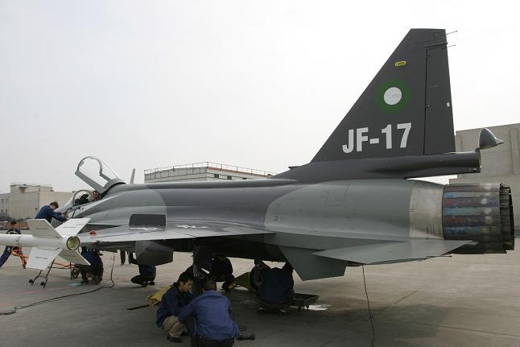
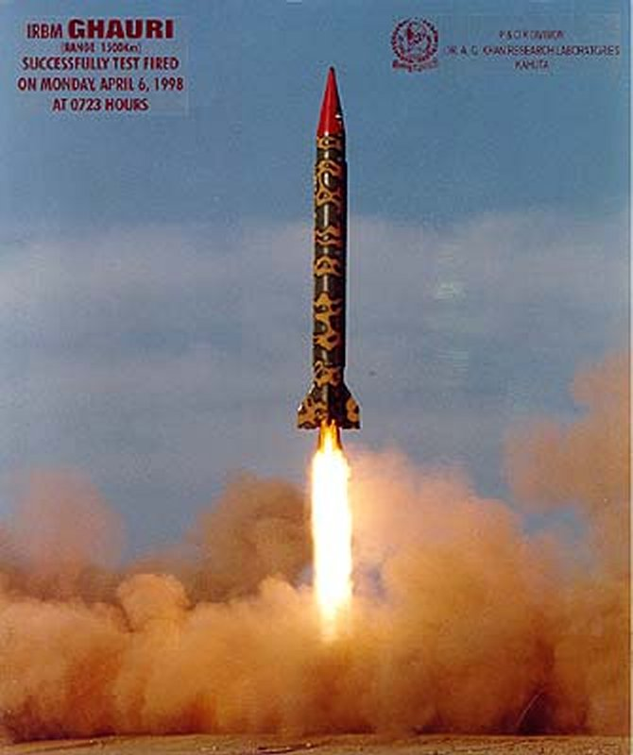
Where can we find software?

Slide 8
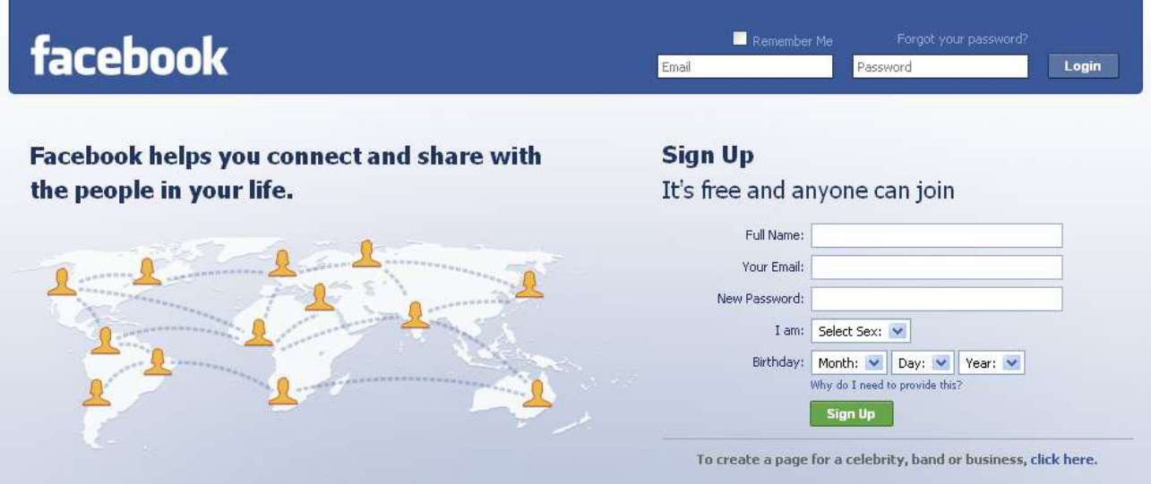
Some popular ones…

Slide 9
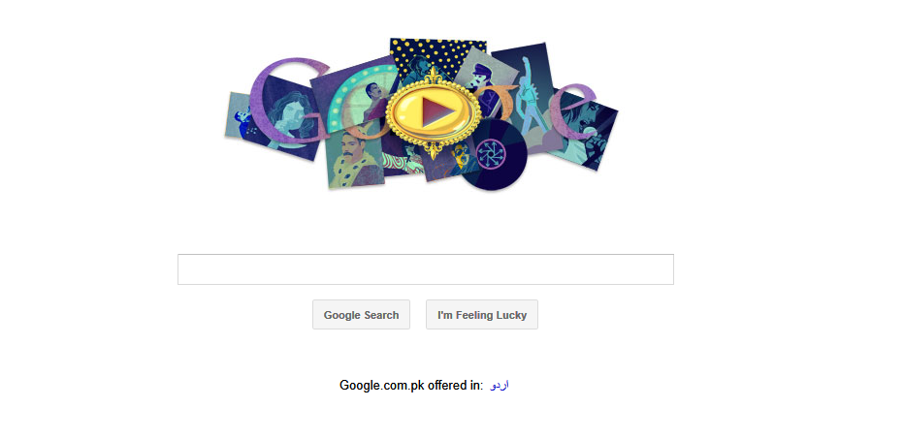
Some popular ones…

Slide 10


And even in…

Slide 11
Conclusion
Software is almost everywhere!!!

Slide 12
Software Applications
Personal Computer Software
Business Software
System Software
Real Time Software
Engineering & Scientific Software
Embedded Software
Web Based Software
Artificial Intelligence Software

Slide 13
Problems in software development
Common issues
The final software does not fulfill the needs of the customer
Hard to extend and improve: if you want to add a functionality later its mission impossible
Bad documentation
Bad quality: frequent errors, hard to use, ...
More time and costs than expected

Slide 14
A clever person solves a problem.
A wise person avoids it.
- Albert Einstein

Slide 15
Solution Software Engineering

Slide 16
SE history
SE introduced first in 1968 – conference about “software crisis” when the introduction of third generation computer hardware led more complex software systems then before.
Early approaches based on informal methodologies leading to
Delays in software delivery
Higher costs than initially estimated
Unreliable, difficult to maintain software
Need for new methods and techniques to manage the production of complex software.

Slide 17
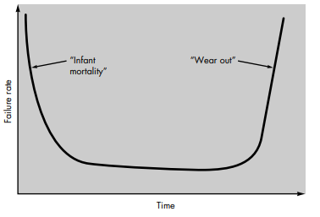
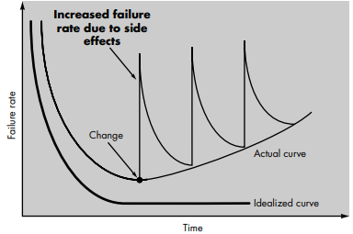
Hardware vs software
Failure curve for hardware
Idealized and actual failure curves for software

Slide 18
What is Engineering?
“The process of productive use of scientific knowledge is called engineering.”

Slide 19
What is Software Engineering?
Systematic approach for developing software
Methods and techniques to develop and maintain quality software to solve problems.
Study of the principles and methodologies for developing and maintaining software systems.

Slide 20
What is Software Engineering?
Practical application of scientific knowledge in the design and construction of computer programs and the associated documentation required to develop, operate, and maintain them.
Deals with establishment of sound engineering principles and methods in order to economically obtain software that is reliable and works on real machines.

Slide 21
What is Software Engineering?
According to the IEEE
Software is:
“Computer programs, procedures, and possibly associated documentation and data pertaining to the operation of a computer system”.

Slide 22
The Role of Software Engineering
A bridge from customer needs to programming implementation
Customer
Software Engineering
Programmer
First law of software engineering
Software engineer is willing to learn the problem domain
(problem cannot be solved without understanding it first)

Slide 23
What is the difference between software engineering and computer science?
Computer Science
Software Engineering
is concerned with
theory
fundamentals
Algorithms, data structures, complexity theory, numerical methods
the practicalities of developing
delivering useful software
SE deals with practical problems in
complex software products
Computer science theories are currently insufficient to act as a complete underpinning for software engineering, BUT it is a foundation for practical aspects of software engineering.

Slide 24
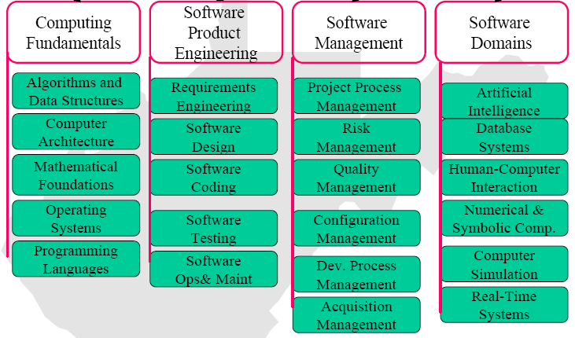
Software Engineering Body of Knowledge

Slide 25
What are the attributes of good software?
The software should deliver the required functionality and performance to the user and should be maintainable, dependable and usable.
Maintainability
Software must evolve to meet changing needs
Dependability
Software must be trustworthy
Efficiency
Software should not make wasteful use of system resources
Usability
Software must be usable by the users for which it was designed
and much more....

Slide 26
Well Engineered software?
It is reliable
It has good user-interface
It has acceptable performance
It is of good quality
It is cost-effective

Slide 27
What are the key challenges facing software engineering?
Software engineering in the 21st century faces three key challenges:
Legacy systems
Old, valuable systems must be maintained and updated.
Heterogeneity
Systems are distributed and include a mix of hardware and software.
Delivery
There is increasing pressure for faster delivery of software.

Slide 28
Questions addressed by Software Engineering
How do we ensure the quality of the software that we produce?
How do we meet growing demand and still maintain budget control?
How do we avoid disastrous time delays?

Slide 29
Why apply Software Engineering to Systems?
Provide an understandable process for system development.
Develop systems and software that are maintainable and easily changed.
Develop robust software systems.

Slide 30
Some Important Software Engineering Related Activities
Project Management
Requirement Engineering
Software Design
Coding
Testing
Software Quality Assurance
Software Configuration Management
Software Integration

Slide 31
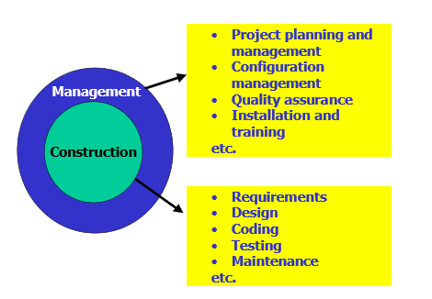
Software Development

Slide 32
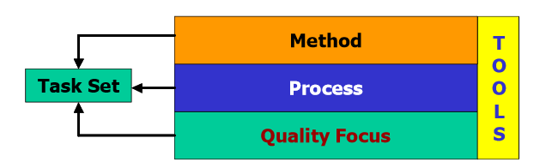
Software Development

Slide 33
Software Development
The activities involved in software development can broadly be divided into two major categories
Construction
Management

Slide 34
Software Development
Construction
Construction activities are related to the development of software.
Requirement Gathering
Design Development
Coding
Testing

Slide 35
Software Development
Management
Management activities are kind of umbrella activities that are used to smoothly and successfully perform the construction activities
Project Planning and Management
Configuration Management
Software Quality Assurance
Installation and Training

Slide 36
Software Development
Questions that have to answer in Software Development
What is the problem to be solved?
What are the characteristics of the entity that is used to solve the problem?
How will the entity be realized?
How will the entity be constructed?
What approach will be used to uncover errors that were made in the design and construction of the entity?

Slide 37
Software Engineering Phases
Definition: What?
Development: How?
Maintenance: Managing change
Umbrella Activities: Throughout lifecycle

Slide 38
Definition
REQUIREMENTS DEFINITION AND ANALYSIS
Developer must understand
Application domain
Required functionality
Required performance
User interface

Slide 39
Definition (cont.)
Project planning
Allocate resources
Estimate costs
Define work tasks
Define schedule
System analysis
Allocate system resources to
Hardware
Software
Users

Slide 40
Development
SOFTWARE DESIGN
User interface design
High-level design
Define modular components
Define major data structures
Detailed design/Low level Design
Define algorithms and procedural detail

Slide 41
Development (cont.)
Coding
Develop code for each module
Unit testing
Integration
Combine modules
System testing

Slide 42
Maintenance
Correction - Fix software defects
Adaptation - Accommodate changes
New hardware
New company policies
Enhancement - Add functionality

Slide 43
Why is software development so difficult?
Communication
Between customer and developer
Poor problem definition is largest cause of failed software projects
Within development team
More people = more communication
New programmers need training

Slide 44
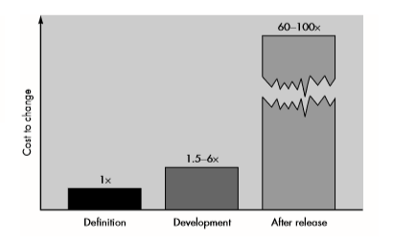
Why is software development so difficult?
Changing requirements
5 x cost during development
up to 100 x cost during maintenance
Hardware/software configuration
Security requirements
Real time requirements
Reliability requirements

Slide 45
Why is software development difficult? (cont.)
Management issues
Cost estimation
Scheduling
Resource allocation
Quality assurance
Version control
Contracts
Personnel characteristics
Ability
Prior experience
Communication skills
Team cooperation
Training

Slide 46
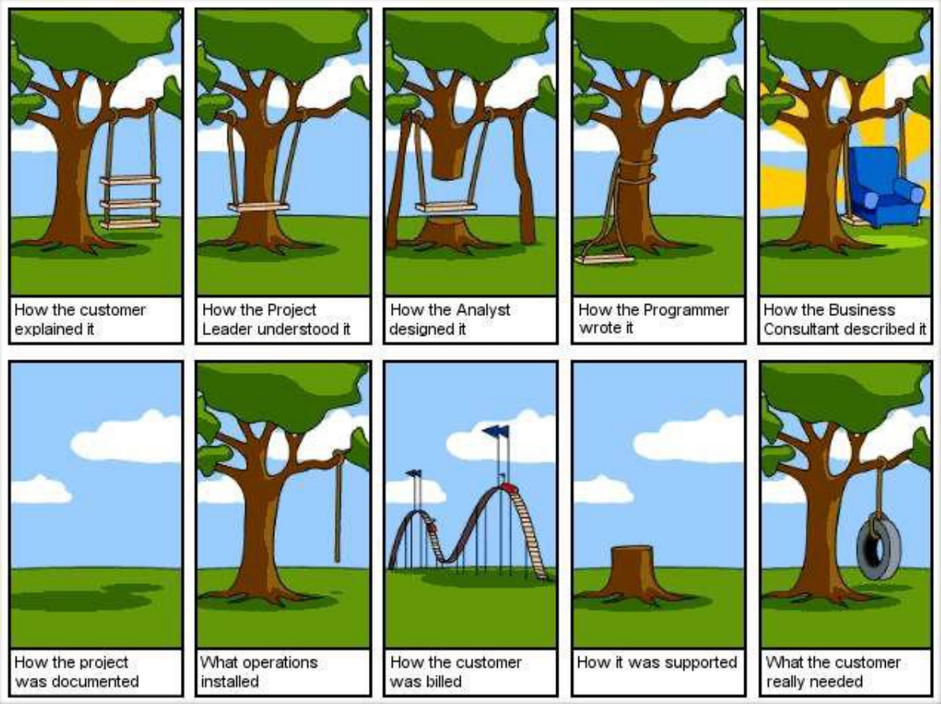
Major problems in software developments

Slide 47
Software myths
Management myths
Add more programmers if behind the schedule.
My people have state-of-the-art software development tools, after all, we buy them the newest computers.
If I decide to outsource the software project to a third party, I can just relax and let that ﬁrm build it.

Slide 48
Software myths
Customer myths
A general description of objectives enough to start coding.
Project requirements continually change, but change can be easily accommodated because software is ﬂexible.

Slide 49
Software myths
Practitioner myths
Once we write the program and get it to work, our job is done.
Until I get the program "running" I have no way of assessing its quality.
The only deliverable work product for a successful project is the working program.
Software engineering will make us create voluminous and unnecessary documentation and will invariably slow us down.

Slide 50
HAVE A GOO DAY!

